Slide 1
MULTIMODAL SENTIMENT ANALYSIS B.TECH FINAL YEAR PROJECT
By: Bhavya Sharma(1805213018)
Himani Jayas(1805213023)
Kokil Gupta(1805213027)
Guide: Dr. Manik Chandra
Co-guide: Mr. Abhishek Singh

Slide 2
Introduction
Sentiment analysis studies the subjective information in an expression, that is, the opinions, appraisals, emotions, or attitudes towards a topic, person or entity. Expressions can be classified as positive, negative, or neutral.
Sentiment Analysis intends to naturally reveal the hidden mentality that we hold towards an entity.
Multimodal Sentiment Analysis is another dimension of the customary text-based assessment investigation, which goes past the test of writings, and incorporates different modalities like sound and video information.
Understanding individuals’ position, disposition, or assessment towards a specific feature has numerous applications. A new improvement in multimodal sentiment analysis is visual assumption investigation.

Slide 3
Related Works
Cambria et al. (2017) stated that a holistic approach to sentiment analysis is required, and only categorization or classification is not sufficient. They presented the problem as a three-layer structure that includes 15 Natural Language Processing (NLP) problems as follows:
Syntactics layer: Microtext normalization, sentence boundary disambiguation, POS tagging, text chunking, and lemmatization
Semantics layer: Word sense disambiguation, concept extraction, named entity recognition, anaphora resolution, and subjectivity detection
Pragmatics layer: Personality recognition, sarcasm detection, metaphor understanding, aspect extraction, and polarity detection
Yadav and Vishwakarma (2020) reviewed 130 research papers that apply deep learning techniques in sentiment analysis. They identified the following deep learning methods used for sentiment analysis: CNN, Recursive Neural Network (Rec NN), RNN (LSTM and GRU), Deep Belief Networks (DBN), Attention-based Network, Bi-RNN, and Capsule Network. They reported that LSTM provides better results, and the use of deep learning approaches for sentiment analysis is promising. However, they stated that they require a huge amount of data, and there is a lack of training datasets.

Slide 4
Objective
1 To create a Multimodal Sentiment Analysis that will extract the sentiments using the three modes, i.e., Audio, Text and Video.
Audio Sentiment Analysis –
The aim of audio analysis is to evaluate the sentiment of an individual throughout the interview. We will be analysing the sentiment of the individual over various parts of the interview by using MFCCs and transformers, which can help us in understanding the transition of his emotion.
Text Sentiment Analysis –
The aim of the text analysis is to evaluate any given text obtained by an individual in the interview process, containing multiple features and varied opinions and then predict the nature of the text. We will use the LSTM model that will predict the tone and classify the nature of the text into three categories, i.e., positive, negative or neutral.
Video Sentiment Analysis –
The aim of the video analysis is to identify sentiments like Happy, Angry, Disgust, etc. As of late, neural network techniques are well known to demonstrate the perplexing interaction between images.
2 Evaluating the datasets by checking the loss and accuracy of our mode and maximizing the quality of results obtained.

Slide 5
Dataset Sources
Text: For the text input, we are using data that was gathered in a study by Pennebaker and King. It consists of 2,468 daily writing submissions from 34 psychology students (29 women and five men whose ages ranged from 18 to 67 with a mean of 26.4).
Audio: For sound informational collections, we are utilizing the "Ryerson Audio-Visual Database of Emotional Speech and Song" (RAVDESS). RAVDESS contains 7356 records (all-out size: 24.8 GB). The information base contains 24 expert entertainers (12 females, 12 guys), expressing two lexically coordinated explanations in a nonpartisan North American pronunciation. Discourse incorporates quiet, glad, miserable, sore, unfortunate, shock, and repugnance articulations, and tune contains quiet, cheerful, dismal, furious, and sad feelings.
Video: For the video informational collections, we are utilizing the well-known FER2013 Kaggle Challenge informational index. The information comprises 48x48 pixel grayscale pictures of countenances. The informational collection remains very testing to use since there are vacant pictures or wrongly ordered pictures.

Slide 6
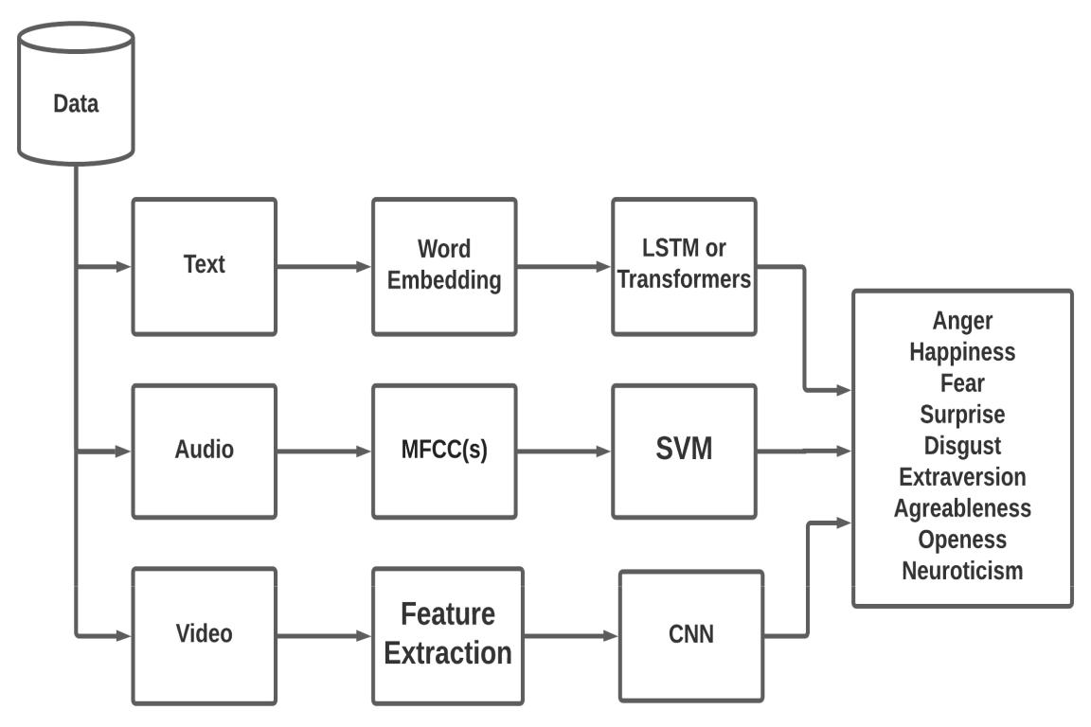
Methodology
System Architecture
The accompanying address the System Architecture and essential working of the Web Application of the Sentiment Analysis. The system is designed to provide sentiments using text, audio and video. The ends of the system consist of a list of emotions that can be predicted using any of the three models with probabilities assigned to each one of them individually.

Slide 7
RNN:
Recurrent Neural Networks (RNNs) are one of the most prevalent architectures because of the ability to handle variable-length texts.
They are networks with multiple loops in them, allowing information to continue.
Word Embeddings:
The text data to be predicted for sentimental analysis is provided to the Word Embeddings module, which is equipped for catching the setting of a word in an archive, semantic and syntactic likeness, connection with different words.
LSTM:
LSTMs are explicitly designed to ignore the long-term dependency problem. Remembering information for a long time is practically their default behavior, not something they struggle to learn.
Long short-term memory (LSTM) is a synthetic recurrent neural network (RNN) architecture employed in the sphere of deep learning. Unlike standard feedforward neural networks, LSTM has feedback connections.
LSTM networks are well-suited to classifying, processing, and making predictions supported statistic data since there may be lags of unknown duration between important events in a very statistic.

Slide 8
MFCC’s:
MFCCS (mel frequency cepstral coefficients) Mel scale -The Mel scale relates perceived frequency, or pitch, of a pure tone to its actual measured frequency. The formula for converting from frequency to Mel scale is: M(f) =1125 ln(1+f/100)
Cepstrum - cepstrum is the information of rate of change in spectral bands. In the conventional analysis of time signals, any periodic component (for eg, echoes) shows up as sharp peaks in the corresponding frequency spectrum (ie, Fourier spectrum. This is obtained by applying a Fourier transform on the time signal). MFCC features represent phonemes (distinct units of sound) as the shape of the vocal tract (which is responsible for sound generation) is manifest in them.
The model can be used to predict six emotions - angry, happy, sad, neutral,fear,disgust.

Slide 9
Implementation Details

Slide 10
Text Sentiment
Initially, RNN models were used for text sentiment analysis, but the problem was that it could not see the future data as word by word inputs were given to the model. Thus, new models came up like the LSTM, Bidirectional LSTM, and Transformers. I used Bidirectional-LSTM in the process that helped to improve the accuracy and decision by the model.
The steps that we will go through this module are:
First of all, the text is cleaned, and unnecessary words are removed using the Tokenization method, and all symbols are removed, and the whole text is made in lower-case.
Then we will create a Bag Of Words that will contain the vocabulary size,i.e., most of the words used in the data.
Embedding Matrix is created which is the strong relationship of words that are nearby like King and Queen, or Apple and Mango are strongly related.
This embedding matrix data is put as an input to the Attention Based Model that we will custom create with Bidirectional LSTM Encoders, Attention Layer, and the Decoders.
Many to One LSTM’s are used to predict the label using the text.

Slide 11
Audio Sentiment
Audio sentiment analysis can detect six feelings, i.e. happy, sad, angry, disgusted, fear, and surprise
The steps that we went through this module were:
Extract 15 seconds audio and add some noise to the data so that model can also be used in the real-life process.
Signal Pre-processing will be done in the next stage, like amplifying high-frequency and splitting audio in frames.
After all this MFCC’s calculated, which are the input data that will be used for the model
Classification models can be used to predict one of the six labels of sentiment.
Printing a bar plot of the sentiments is achieved by using Argmax computation.

Slide 12
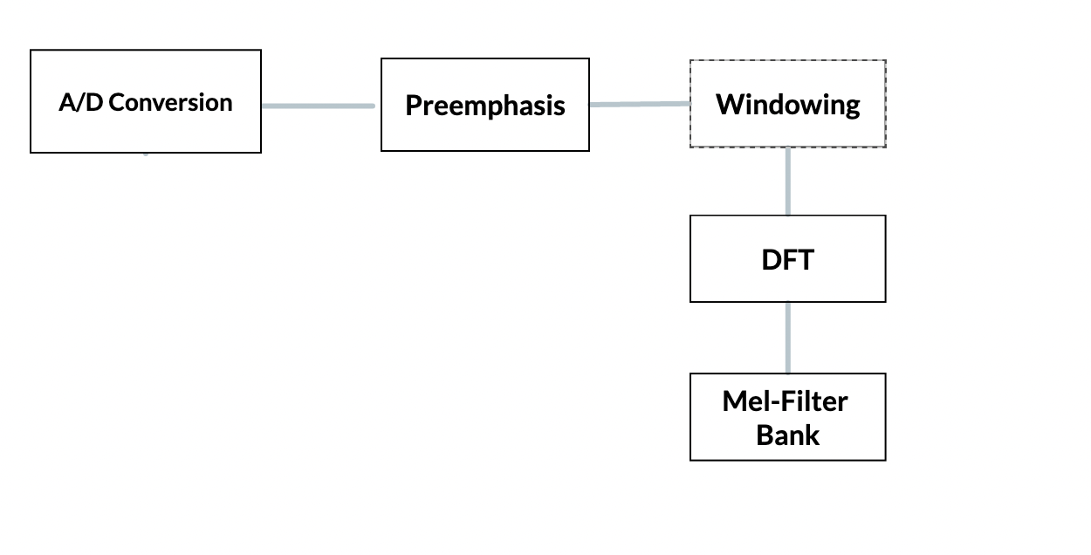
MFCC

Slide 13
Video Sentiment
The work that is done on the Facial Expressions has been trained over FER2013 Kaggle Challenge dataset and has obtained a good accuracy while using the Xception transfer learning model.
First of all, the video is split into frames, and the analysis is done step by step.
Filters are used after getting the frames, and Convolution Operations are per- formed.
Features Extraction is done, and landmark points are located in those frames.
The image is flattened and fed to the Exception Model for an output.

Slide 14
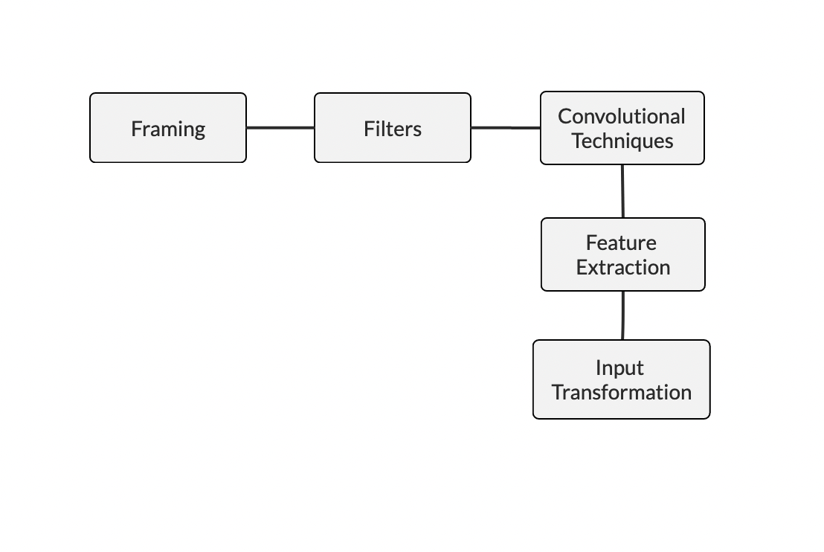

Slide 15
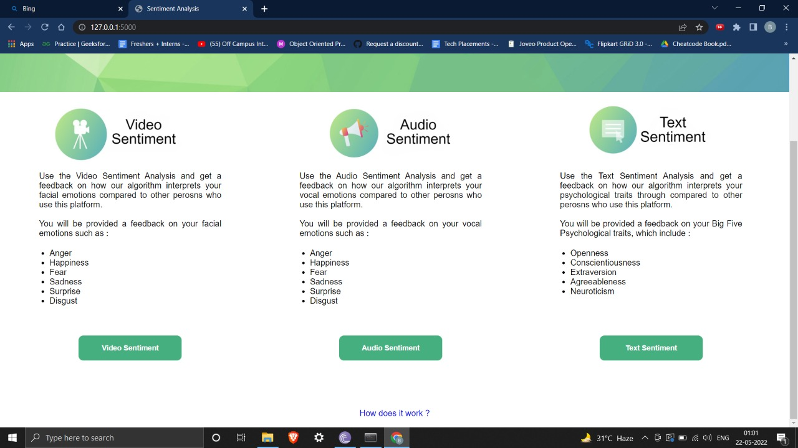
Flow of the Web-App

Slide 16
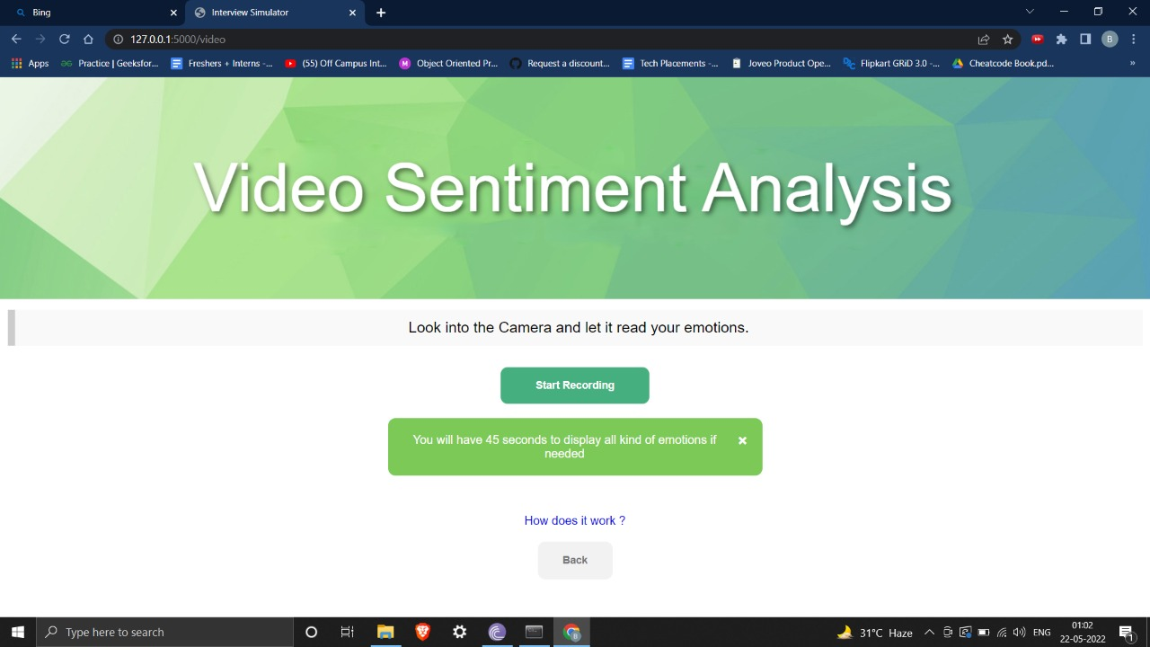

Slide 17
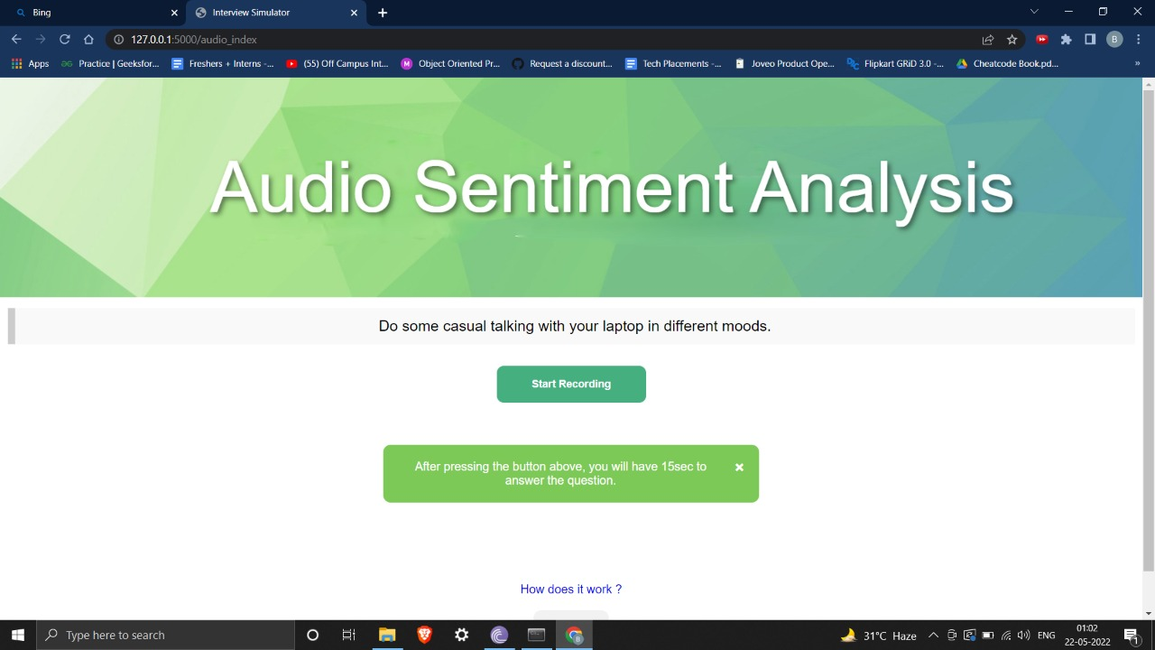

Slide 18
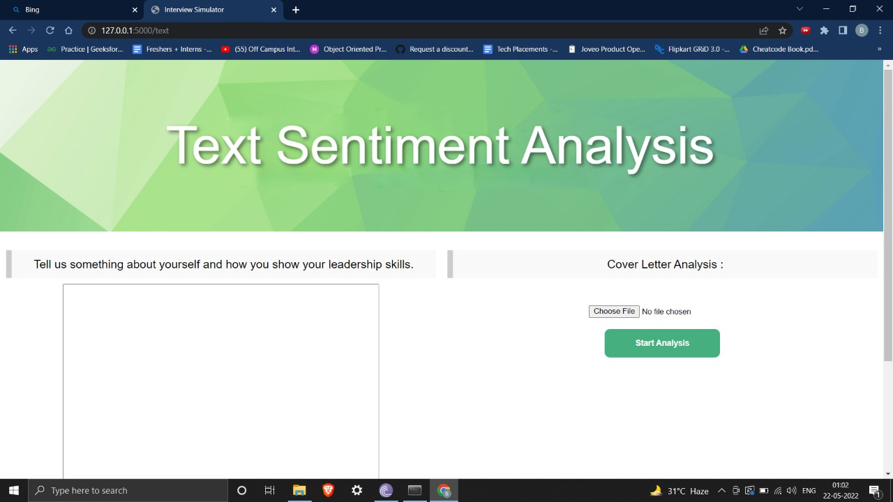

Slide 19
Results
The Web-App is to be designed with three sections with Text, Audio, and Video Sentiment Analysis. The user will type in the Text Sentiment Analysis, which will use the LSTM techniques to predict the Sentiment of the data by a particular label that has been defined during the training. The Audio sections take the audio file as input in a .wav file and predict the Sentiment by calculating the MFCC’s and predicting the label used in training. In the video section, real-time camera access is needed for the input of the Sentiment Analysis, and the facial expressions determine the Sentiment.

Slide 20
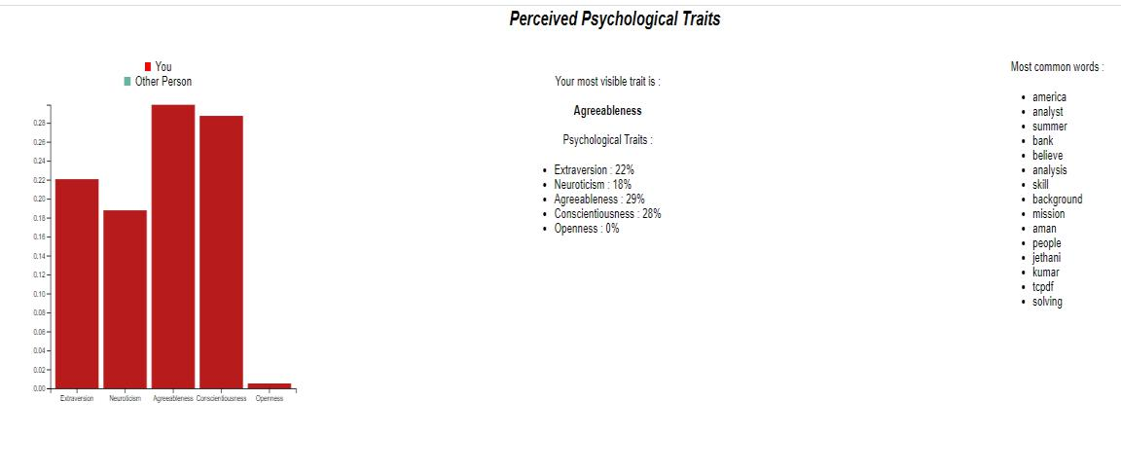
Text Sentiment

Slide 21
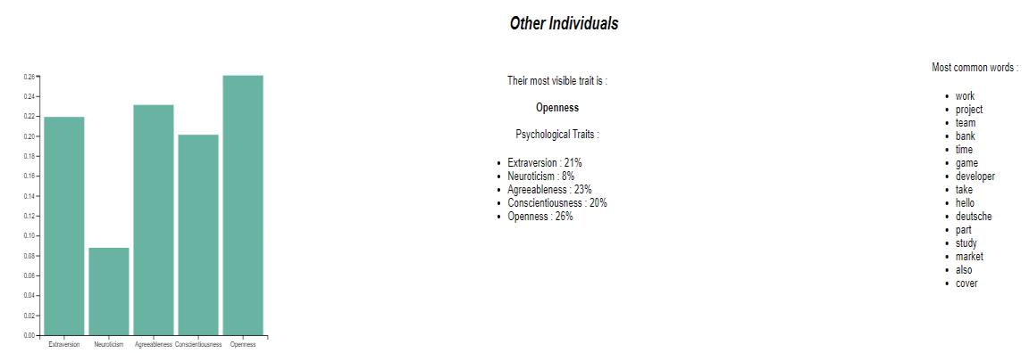

Slide 22
The accuracy by using different models is shown below. The method that has been used is Word-2-Vec embedding with LSTM and SVM models. Both the accuracy of the test set is shown below.
Table 5.1 shows the accuracy of labels with two different types of models. LSTM helped us increase the accuracy because LSTM is used as a Bidirectional and can see any independence of the current word with the future.
Model | EXT | NEU | AGR | CON | OPN
Word2Vec + SVM | 46.18 | 48.21 | 49.65 | 49.97 | 50.07
Word2Vec + LSTM | 55:07 | 50:17 | 54:57 | 53:23 | 53:84
Text Accuracy Confusion Matrix

Slide 23
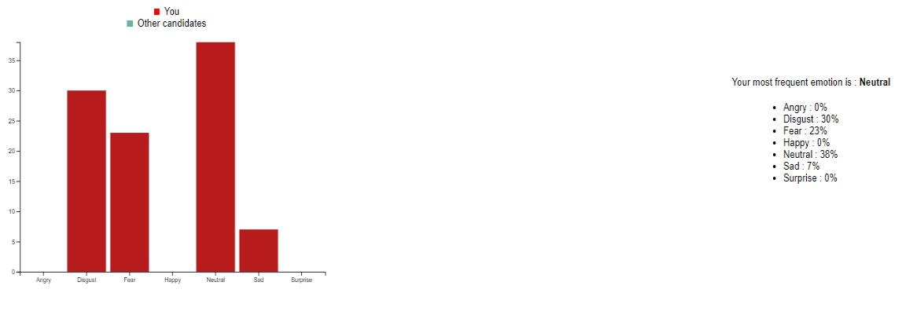
Audio Sentiment

Slide 24
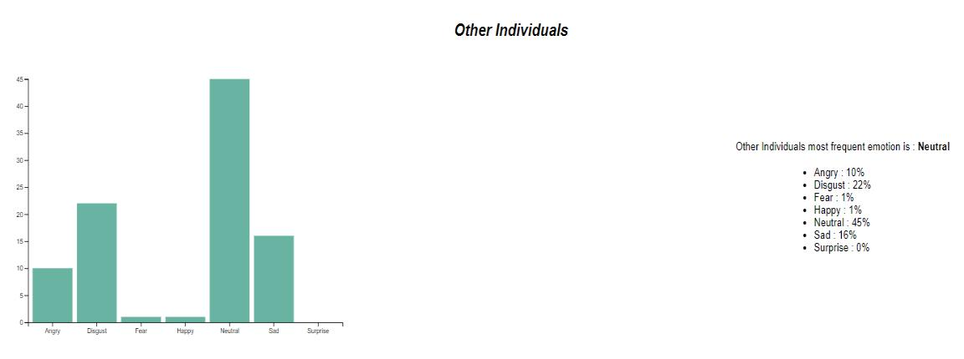

Slide 25
This Audio modal have been implemented with MFCC’s calculation and then fed those MFCC’s to the Classification Network using the Neural Networks. The confusion matrix accuracy of each label is given below.
shows the accuracy of all labels using MFCC’s fed to some of the classification methods with the use of Neural Networks.
 |  |  |  | Predicted labels
 | Happy |  | Sad | Angry | Scared | Neutral | Disgusted | Surprised
 |  |  |  |  |  |  | gusted | prised
Happy | 80.0% |  | 0.0% | 5.7% | 5.7% | 5.7% | 2.9% | 3.4%
Sad | 8.1% |  | 81.1% | 0.0% | 0.0% | 2.7% | 8.1% | 1.5%
Angry | 6.3% |  | 6.3% | 75% | 0.0% | 6.3% | 6.3% | 0%
Scared | 6.7% |  | 0.0% | 4.4% | 71.1% | 8.9% | 8.9% | 4.7%
Neutral | 11.1% |  | 5.6% | 2.8% | 8.3% | 66.7% | 5.6% | 0.3%
Disgusted | 0.0% |  | 8.7% | 0.0% | 4.3% | 2.2% | 84.8% | 2.9%
Surprised | 0.0% |  | 8.7% | 0.0% | 4.3% | 2.2% | 84.8% | 67.3%

Slide 26
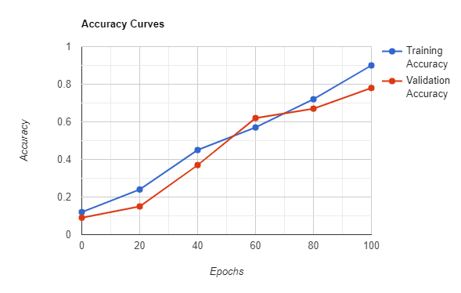
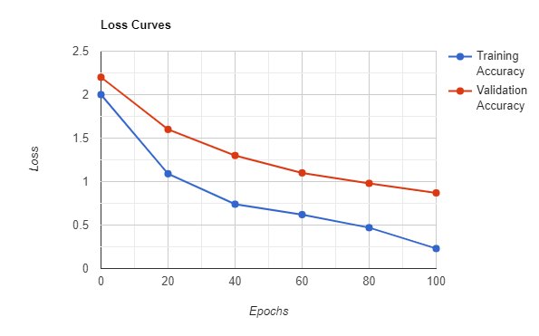
The Audio model’s accuracy and loss graph plot is shown below, and the Final Accuracy can be seen from them predicting those six labels.
Audio Sentiment Accuracy Curve
Audio Sentiment Loss Curve

Slide 27
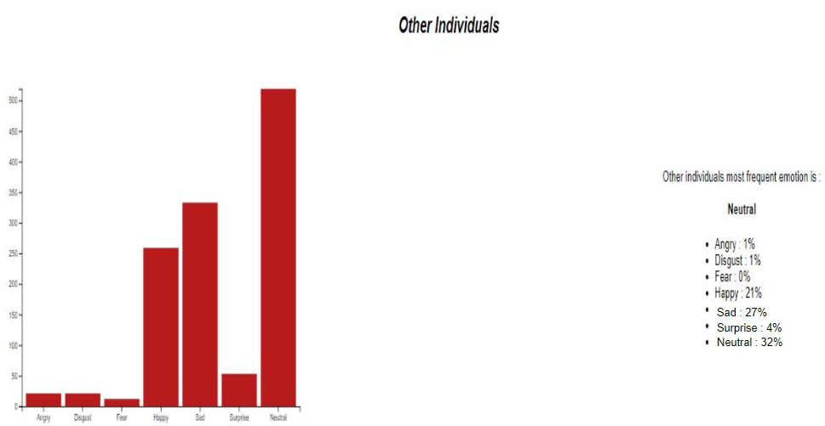
Video Sentiment
Probability Bar Plot For Our Input Live Video

Slide 28
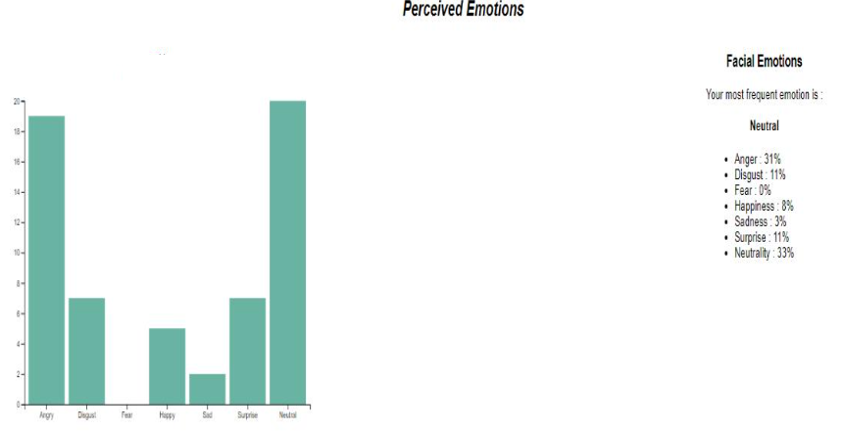
Probability Bar Plot Of Other Individuals
The above figures gives us the label prediction i.e. the emotion with highest probability of our video feed and also comparison with other individuals respectively.

Slide 29
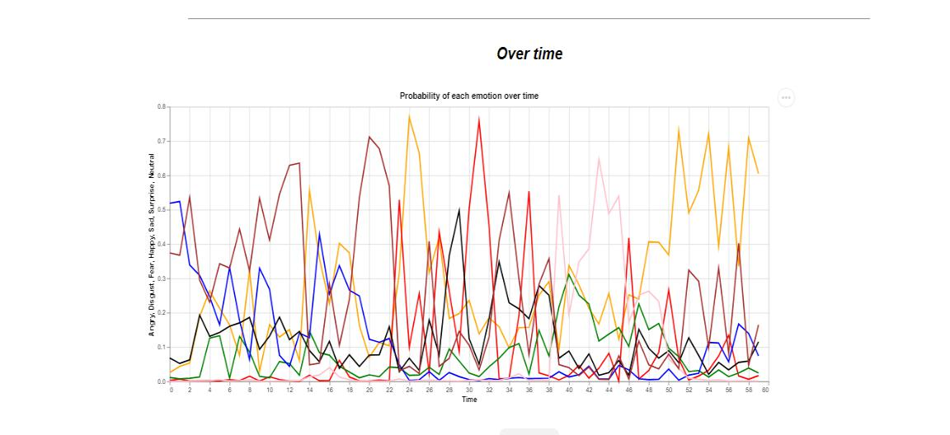
Line Chart for Varying Emotions
This figure shows us how our emotions vary concerning the time using a line chart that can be used in the long run to get the mean Sentiment. We have used the Xception model that is a Transfer Learning Model and is used in competition for predictions of the 1000 labels.

Slide 30
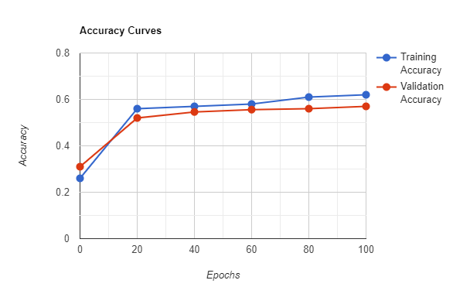
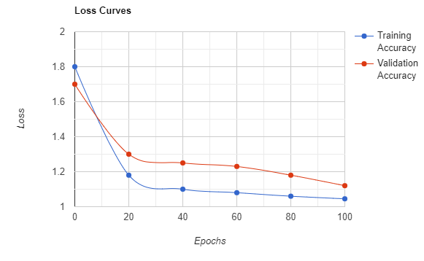
Xception Accuracy Graph
Xception Loss Graph
The figures show the trend of the Accuracy and Loss of the trained and tested model using the Xception Transfer Learning.

Slide 31
Applications
Social media monitoring - Social media posts often contain some of the most honest opinions about your products, services, and businesses because they’re unsolicited. With the help of sentiment analysis software, you can wade through all that data in minutes, to analyse individual emotions and overall public sentiment on every social platform.
Customer support ticket analysis - Sentiment analysis with natural language understanding (NLU) reads regular human language for meaning, emotion, tone, and more, to understand customer requests, just as a person would. You can automatically process customer support tickets, online chats, phone calls, and emails by sentiment to prioritize any urgent issues.
Business Intelligence Buildup - Sentiment analysis enables you to determine how your product performs in the market and what else is needed to improve your sales. You can also analyze the responses received from your competitors. Based on the survey generated, you can satisfy your customers needs in a better way. You can make immediate decisions that will help you to adjust to the present market situation.
Market Research and Analysis - Business intelligence uses sentiment analysis to understand the subjective reasons why customers are or are not responding to something, whether the product, user experience, or customer support. Sentiment analysis will enable you to have all kinds of market research and competitive analysis. It can make a huge difference whether you are exploring a new market or seeking an edge on the competition.

Slide 32
Conclusion
We have developed a web application that helps us in identifying the emotions of an Individual. We created a Multimodal Sentiment Analysis that extracts the sentiments using the three modes, i.e., Audio, Text and Video. It can be used if used in all modes of communication, i.e., Text, Audio and Video. We have evaluated the datasets by checking the loss and accuracy of our model.
LIMITATION -
The dataset for the audio and video sentiment is too large that it requires a great time in training and getting better results. The model is fed with the data-set that accounts for limited emotions. The model might not be able to detect if the emotions to be analysed are other than what the model was trained with.

Slide 33
Future Scope-
We can improve the mode of Text by using BERT techniques, and the Audio field can be improved by combining multiple techniques HMM, CNN, and MFCC, together.
We can give more accurate results if we use 2 modes at once like Audio and Video together to get the better accuracy for the predicted labels

Slide 34
References
https://www.researchgate.net/publication/337732023_Sentiment_analysis_using_deep_learning_architectures_a_review
Cambria E, Poria S, Gelbukh A, Thelwall M (2017) Sentiment analysis is a big suitcase. IEEE Intell Syst 32(6):74–80. https://sentic.net/sentiment-analysis-suitcase.pdf
Y. Jia and S. SungChu, “A deep learning system for sentiment analysis of service calls,” ArXiv, vol. abs/2004.10320, 2020. https://link.springer.com/chapter/10.1007%2F978-1-4614-3223-4_13

Slide 35
THANK YOU!!

